Slide 1
Strategy Pattern
Behavioral Design Pattern

Slide 2
GoF Patterns
Creational Patterns (5)
Deals with initializing and configuring classes and objects
Structural Patterns (7)
Deals with decoupling interface and implementation of classes and objects
Behavioral Patterns (11)
Deals with dynamic interactions among societies of classes and objects (i.e. how they distribute responsibilities)
* The strategy pattern is behavioral design pattern.

Slide 3
Simplified Design Principles
We looked at the SOLID design principles. As we study design patterns we’ll see how these principles are upheld in the patterns and put them in simplified terms

Slide 4
Simplified Design Principles
Identify the aspects of your application that vary and separate them from what stays the same.
The OO term is to “encapsulate” what varies so it won’t affect the rest of your code.
Should result in fewer unintended consequences when code changes and more flexibility in your application.

Slide 5
Simplified Design Principles
Code to an interface, not an implementation
Term interface is overloaded here… really means super type. Could be an interface or an abstract or super class.
An example is to use an interface to represent behaviors
Then create a set of classes whose entire reason for being is to represent the behavior implementing the interface.
The point of this principle is to exploit polymorphism.

Slide 6
Simplified Design Principles
Favor composition over inheritance
Composition provides more flexibility
Composition allows changing behavior at runtime!!!

Slide 7
Strategy Pattern
Defines a family of algorithms, encapsulates each one, and makes them interchangeable. Strategy lets the algorithm vary independently from clients that use it.
Used when you want to choose the algorithm to use at runtime.

Slide 8
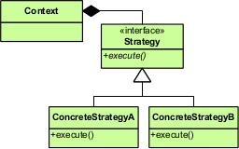
Strategy Pattern

Slide 9
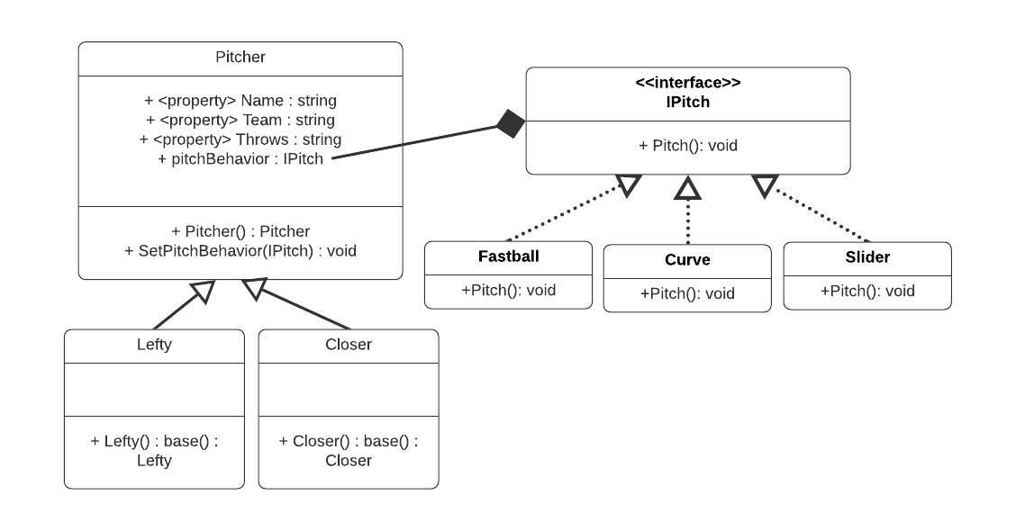
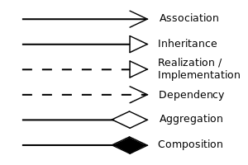
Strategy Pattern Example

Slide 10
Strategy Pattern
Pros
Prevents conditional statements
Algorithms are loosely coupled from the context entity.
Can be changed/replaced without changing the context entity
Easy to Extend
Cons
Application must be aware of all strategies to select the right one in the right situation
In some cases the context must supply relevant data to the strategy making them more tightly coupled.
Increases the number of objects in the application

Slide 11
Questions

